Slide 1
Applets and HTML
Chapter 14

Slide 2
Objectives
Write applets
Write simple HTML documents
Embed an applet in an HTML document

Slide 3
Applet Basics
"Applet" stands for small application
Applets are similar to a Swing GUI
An applet is an object derived from class JApplet
  Must use
  import javax.swing.JApplet;
A JApplet object is a container
  Possible to add components to the object

Slide 4
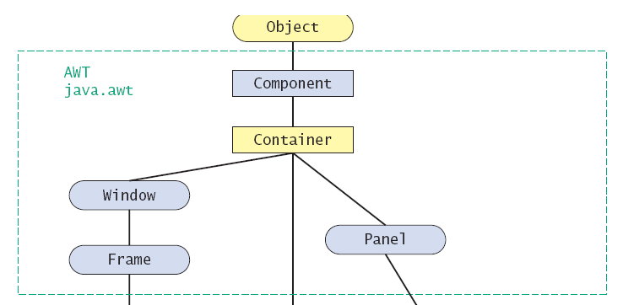
Applet Basics
Figure 14.1 placing applets in the class hierarchy
Object

Slide 5
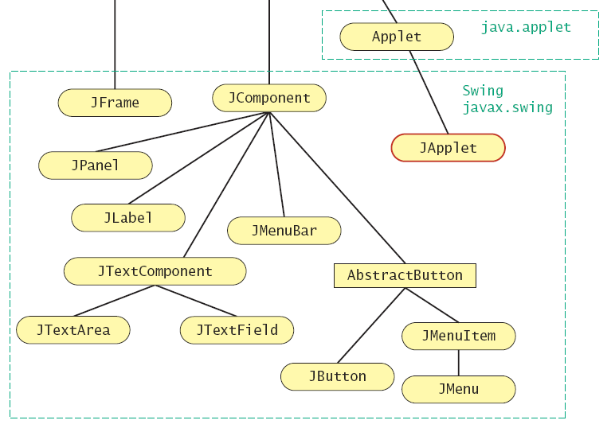
Applet Basics
Figure 14.1 placing applets in the class hierarchy

Slide 6
Applet Basics
Applets do not use constructors
  Initialization code placed in method init()
Normal way to run an applet is as part of a web page
Also possible to run the applet with an applet viewer

Slide 7
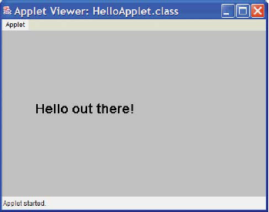
A Trivial Applet
View sample applet, listing 14.1
class HelloApplet
Sample
screen output

Slide 8
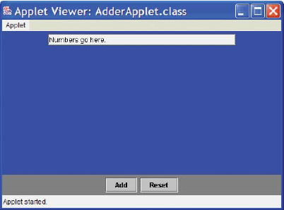
An Adder Applet
Consider an applet which performs addition – same as in chapter 13
View code, listing 14.2
class AdderApplet
Sample
screen output

Slide 9
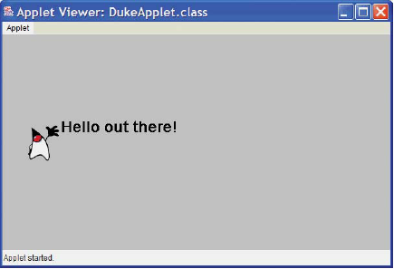
Adding Icons to an Applet
An icon is an ImageIcon object that represents a picture
View sample applet, listing 14.3
class DukeApplet
Sample
screen output

Slide 10

Introduction to HTML
Stands for HyperText Markup Language
It is a language for writing web pages
  It uses tags to mark text
Typical command format
Note: HTML is not case
sensitive
An HTML file is an ordinary text file

Slide 11
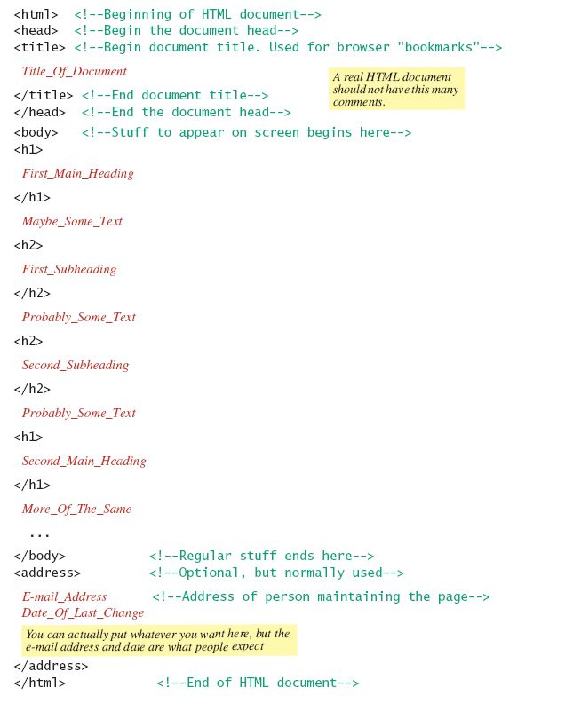
Outline of Simple HTML Document
Listing 14.4a

Slide 12
Outline of Simple HTML Document
Listing 14.4b

Slide 13
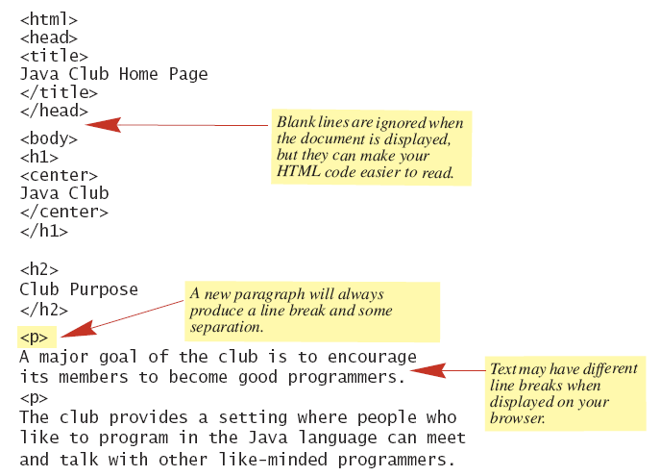
Example of an HTML Document
Listing 14.5a

Slide 14
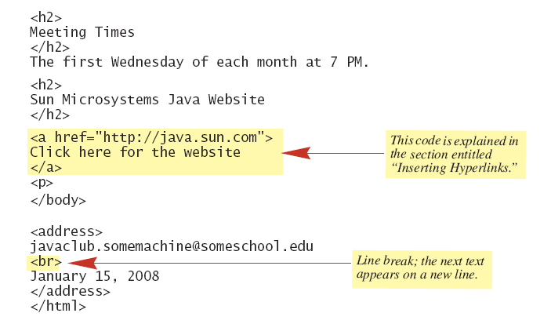
Example of an HTML Document
Listing 14.5b

Slide 15
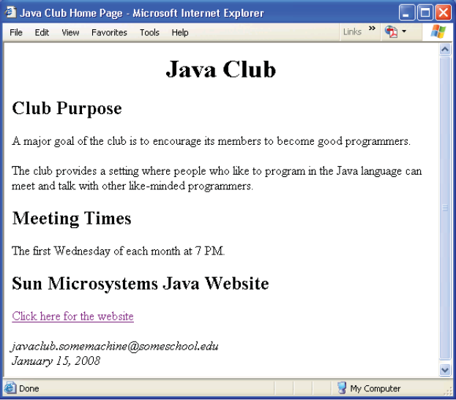
Browser Output

Slide 16
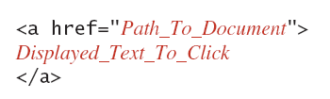
Inserting Hyperlinks
Provides an active element of the web page
Links to other web locations
Syntax:

Slide 17

Displaying a Picture
HTML document can contain both text and pictures
Syntax options:

Slide 18
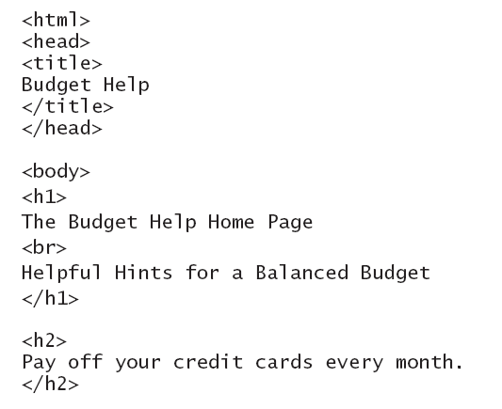
Applets in HTML
Applets may be
imbedded in
HTML
documents,
listing 14.6a

Slide 19
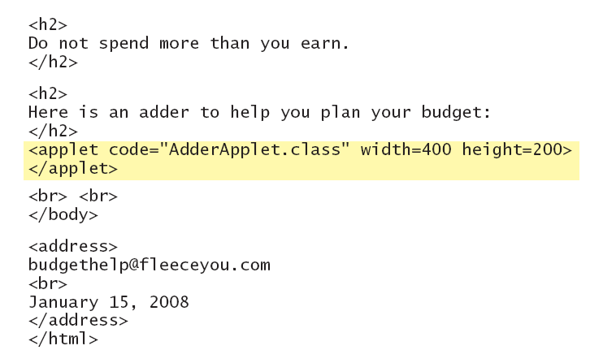
Applets in HTML
Applets may be imbedded in HTML
documents – listing 14.6b

Slide 20
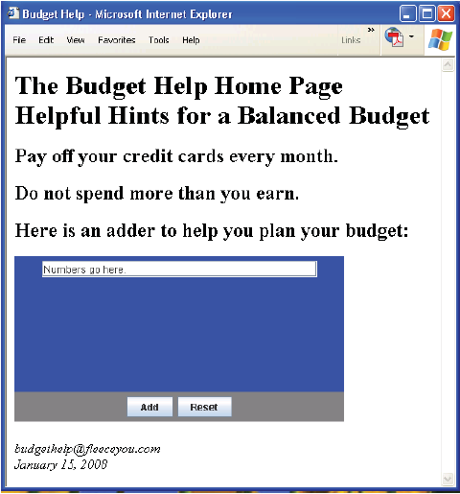
Browser Output
Listing 14.6c

Slide 21
Applets and Security
On a remote computer, applets cannot
  Run programs
  Access files
Be warned that other programs besides applets can run via the browser
  Protection software is advised

Slide 22
The Older Applet Class
Use
import Java.applet.Applet;
Does without the Swing classes
Has no content pane
  Use .add() method with the applet itself

Slide 23
Summary
Applets are Java programs designed to be placed in and run from a Web document.
Applets are similar to Swing GUIs derived from the class JFrame.
An applet is normally a derived class of the class JApplet.

Slide 24
Summary
An applet normally has no main method and no constructors.
  Method init serves the same purpose as a constructor for an applet
An applet’s init method does not include any invocations of
  addWindowListener,
  setTitle
  setSize.

Slide 25
Summary
HTML documents are designed to be read and displayed by a web browser
HTML stands for HyperText Markup Language
Applets can be imbedded in, run from an HTML document

